Slide 1
Luxury Housing Market Analysis – Bengaluru Region
End-to-End Data Analysis using Python, MySQL, and Power BI
Analyzing Developer Trends, Pricing, and Buyer Segmentation
Presented by:
Shashwath E P
AIML-S-WE-T-B32

Slide 2
Statement & Approach
Problem Statement
Build a complete real estate analytics solution using Python for advanced data cleaning, load the refined dataset into a SQL database, and use Power BI to directly connect to SQL and build a dashboard. The goal is to replicate a real-world enterprise-level data pipeline and analysis environment using a complex housing dataset with 1,00,000+ records.
Project Background
The luxury housing market in Bengaluru generates large datasets
Understanding pricing, demand, and buyer types is important
This project analyzes housing data to:
Study developer performance
Identify high-demand configurations
Analyze buyer segmentation
Understand geographic distribution

Slide 3
Project Overview
Housing data
Buyers
Market Factors
Analyze buyer types (CXO, HNI, NRI)
Understand buyer distribution
Analyze amenity scores
Evaluate infrastructure and connectivity
Analyze number of housing projects
Track pricing trends across locations
Identify high-demand configurations
The luxury housing dataset forms the foundation of this analysis, providing insights into Bengaluru’s real estate market across micro-markets, developers, pricing trends, and buyer segments.

Slide 4
Project Objectives
Market Analysis
Regional Performance
Buyer Insights
Trend Analysis
Evaluate total number of projects
Analyze pricing trends
Identify top micro-markets
Compare housing demand across locations
Analyze buyer type distribution
Identify dominant buyer segments
Track price trends over time
Analyze project growth by quarter
These objectives collectively provide a comprehensive understanding of Bengaluru’s luxury housing market, highlighting trends in pricing, demand, developer performance, and buyer behavior.

Slide 5
Tools & Technologies
Python
Pandas & NumPy
MySQL
Core language for data cleaning and preprocessing
Handles CSV data loading and transformation
Used for data preparation before database storage
Data cleaning, transformation, and aggregation
Efficient handling of large housing datasets
Supports feature engineering and data analysis
Structured storage for cleaned housing data
Enables efficient querying of property datasets
Supports analysis across developers and locations
Power BI
GitHub
Creates interactive dashboards and visualizations
Supports filters, slicers, and KPI metrics
Enables dynamic analysis of housing market trends
Version control for project management
Stores code, SQL scripts, and documentation
Tracks changes and supports collaboration

Slide 6
Project Workflow
An end-to-end pipeline transforming raw housing data into actionable insights
Step 1
Step 2
Step 3
Step 4
Step 5
CSV Dataset
Python Processing
Data Cleaning
MySQL Database
Power BI Dashboard
Raw Data Source
Data Extraction
Transformation
Structured Storage
Interactive Visualization
Raw housing dataset in CSV format and contains property, pricing, and buyer details
Load dataset using Python and Preparing data for cleaning and transformation
Handle missing values and inconsistencies and converts data types and standardize columns
Store cleaned data in structured tables , Enables efficient querying and analysis
Create interactive dashboards and KPIs by visualizing trends using charts, filters, and maps

Slide 7
Dashboard & Key Insights: Interactive dashboard provides insights into housing trends, pricing, and market distribution
Dashboard Features
• Developer, micro-market, and configuration filters for dynamic exploration
• Interactive charts for analyzing pricing, demand, and distribution
• KPI cards displaying total projects, average price, and amenity scores
• Map visualization showing geographic distribution of housing projects
Key Insights
• Certain developers dominate the luxury housing market in Bengaluru
• High demand observed for 3BHK and 4BHK configurations
• Some micro-markets show higher concentration of housing projects
• Buyer segmentation includes CXO, HNI, NRI, and other categories
The dashboard transforms complex housing data into actionable insights, enabling intuitive exploration of Bengaluru’s luxury housing market across multiple dimensions.

Slide 8
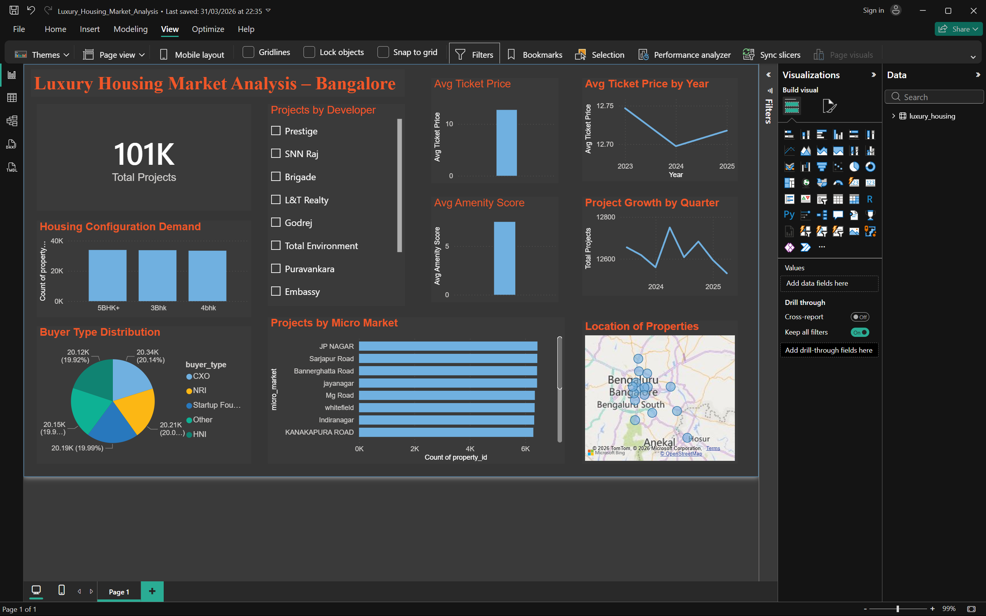
Dashboard

Slide 9
Challenges & Conclusion: Overcoming data challenges to deliver a scalable housing analytics solution
1
2
3
Challenges Faced
Conclusion
Future Scope
• Handling missing and inconsistent housing data
• Converting price and numeric fields into proper formats
• Ensuring smooth integration between Python, SQL, and Power BI
• Built a complete data analytics pipeline from raw data to dashboard
• Transformed housing data into meaningful visual insights
• Developed an interactive Power BI dashboard for market analysis
• Add predictive models for housing price forecasting
• Integrate real-time real estate data sources
• Expand analysis to multiple cities beyond Bengaluru
This project demonstrates a scalable approach to analyzing housing market data, transforming raw datasets into actionable insights through an end-to-end analytics pipeline.

Slide 10
Practical Implementation
Business Applications
1. Strategic Decision Making
Helps real estate companies identify:
High-demand locations
Profitable configurations (3BHK, 4BHK)
2. Developer Performance Analysis
Compare developers (Prestige, Brigade, etc.)
Identify top-performing builders
3. Targeted Marketing
Understand buyer types:
HNI → luxury marketing
NRI → international campaigns
4. Pricing Strategy
Set competitive prices based on:
Market trends
Location demand
5. Location Intelligence
Identify high-growth micro-markets
Plan new projects in profitable areas
IT Industry
Development of data pipelines (ETL) for processing large datasets
Building interactive dashboards (Power BI) for decision-making
Integration of databases (MySQL) with analytics tools
Foundation for AI/ML models like price prediction
Finance Industry
Real estate investment analysis using pricing trends
Loan risk assessment based on property values
Market forecasting for housing demand
Customer segmentation (HNI, NRI, CXO buyers)

